Slide 1
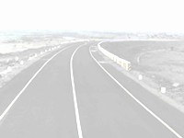
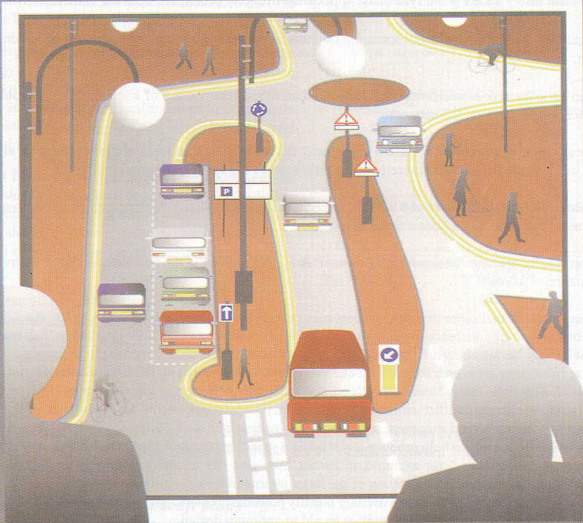
Road Safety Audit

Slide 2
Contents
Definition, Aims and Benefits
Why accidents occur despite the use of current design standards?
Concepts of Road Safety Audit
Road Safety Auditors & key personnel
Organising and conducting the Road Safety Audit
Road Safety Audit Report
Examples and commonly identified issues in RSA

Slide 3
Road Safety Audit
A formal procedure for
  assessing accident potential
  assessing safety performance of
    existing road
    future road
    traffic related project or
    project, which interacts with road users
Input to the design process
  separate from actual design
Focus on physical elements of road

Slide 4
Aims of Road Safety Audit
Specific aims are to:
Minimise risk and severity of accidents
Minimise/ avoid accidents on network
Meet the needs of safe use by all users
Reduce long term cost of scheme
Improve awareness of safe design practices

Slide 5
Benefits of Road Safety Audit
Potential for accident savings by 3% (U.K.)
Savings in cost to community (accident costs – Rs.19,000 crore annually)
Safer highways – accident prevention
Safer road network
Reduced whole life cost of road schemes
Explicit consideration of safety for vulnerable road users
Enhancement of road safety issues

Slide 6
Road Safety Audit is NOT
An opportunity to redesign a scheme
A technical/design standards check
Not a means of rating one project against another
An opportunity to raise subjective personal concerns
An accident investigation

Slide 7
“When the road safety audit process is applied to an existing road, it is called a Road Safety Audit Review (RSAR)”.

Slide 8
Underlying Concepts
Prevention is better than cure
  Less trauma
  Less money for treatments
Drive, Ride, Walk in Safety
  Less accident costs over whole economic life of project

Slide 9
RSA: Prevention is Better than Cure
Accident Investigation
  On existing roads investigate accidents and treat problems
  Monitors and Evaluates
Road Safety Audit
  Attempt to predict accidents and road safety problems in new designs and recommend modifications to minimize these problems
  Prevent future accidents

Slide 10
Type of Projects for Safety Audit
New Expressways
Major divided carriageway roads
Reconstruction and realignment projects
Pedestrian and bicycle routes
Deviated local roads near major projects
Local area traffic management schemes
Signal upgrading
Accident reduction schemes
Maintenance works

Slide 11
Stages of Road Safety Audit
Feasibility Stage
  Route options, layout options, standards, impact on network
Draft Design Stage
  Layout, geometrics, land implications, concept of sign and markings
Detailed Design Stage
  Geometrics, intersections, signs, markings, lighting, impact protection
Pre-opening Stage
  Drive/ cycle/ walk/ ride, in day, night and in inclement weather, as user
Existing Roads
  Safety hazards identification to prevent accidents

Slide 12
Programming of Audit Stages
Stage | F | Draft Design | F/ Draft Design | Detail Design | Draft Design / Detail Design | Const. | Pre-open-ing
Scheme
Major Highway Schemes | * | * |  | * |  | * | *
Minor Highway Schemes |  | * |  | * |  |  | *
Traffic Management / Traffic calming |  |  | * | * |  |  | *
Accident Remedial Schemes |  |  |  |  | * |  | *
Major Maintenance Schemes |  |  | * | * |  |  | *
Major Development Schemes | * | * |  | * |  |  | *
Expressways | * | * |  | * |  |  | *
Temporary Traffic Management of Major Schemes |  |  |  |  | * | *

Slide 13
Audit Process
The steps
Responsibility of
Select the Audit Team
…………………………
Client or Designer
Provide the Background Information
……………………………
Designer
Hold a Commencement Meeting
………………………
Client/ Designer and Audit Team
Assess the Documents
…………………
Audit Team
Inspect the Site
Write the Audit Report
……………………………
Audit Team
Hold a Completion Meeting
…………………………
Audit Team and Client/ Designer
Write the Responses
……………………………
Client and Designer
Implement the Changes
……………………………
Designer

Slide 14
Resources for Safety Audit
Team
  Average two persons
  Around seven for major schemes
Time required
  25 person hours
  45 person hours for major schemes
Audit cost
  Ranging from Rs 5,000 to Rs. 10,000 per km of Road
Redesign cost
  0.5% of original construction cost of major schemes
  3% of original construction cost of small schemes
Positive economic benefit

Slide 15
Selection of Auditor
Auditor is Independent
  team or individual
  application of ‘fresh eyes’ to the task
Adequate experience
  trained or worked on previous audit

Slide 16
Selection of Auditor (contd.)
Necessary Skills
  road safety engineering
  traffic engineering
  traffic management
  road design
  accident investigation and prevention
Correct Aptitude
  ability to identify potential safety problems from different road users’ view point

Slide 17
Safety in Different Stages of the Project
Stage of the Project | Focus of the Audit
Feasibility | Safety issues associated with options such as route locations, design speed and standards, impact on adjacent network, provision of intersections and interchanges, access control, no. of lanes, traffic control, functionality, future needs
Preliminary Planning Report (PPR) | Evaluation of general design standards, alignment, sight distance and lines of sight, intersection layout, lanes and shoulder widths, cross-slopes, provision for buses, cycles, pedestrians, emergency vehicles, rest areas, parking etc., safety during construction
Detailed Planning Report (DPR) | Examining safety issues of specific geometric design features, traffic control devices, delineation, road side clear zones, intersection details, glare screens and lightning, safety issues related to landscaping, provision for special road users like elderly, school children, buses, equestrian, rail roads, heavy trucks etc.
Pre-opening | Final check prior to opening the facility to ensure that the safety concerns of all road users have been addressed and that the hazardous conditions have been eliminated. Should include day/night checks; evaluation considering dry/wet weather; driving/riding and walking
Final Stage | An audit of existing roadway to determine, if the safety needs of all road users are currently being served. It recognizes that a roadway may change over time. Changes may have resulted from changing road use, encroachments, design inconsistency, aging infrastructure and inadequate maintenance. Points to be emphasized are adequacy of roadway, road side and intersections, location of bus stops, interaction of VRUs, access management

Slide 18
Who Should Carry Out
Safety Audit?
Must be independent of the design team
Team of at least two people
At least one safety engineering “expert”
Others
  Highway engineers
  Road safety education specialist
  Traffic police
  Maintenance specialist

Slide 19
Road Safety Strategy
Audit is an integral part of a road safety strategy
Helps to prevent accidents that you may otherwise need to treat in future
Can save money
Promotes an understanding of safe design practice for designers and managers
Will help significantly in achieving road casualty reduction targets

Slide 20
What to Look for in RSA?
Mistakes
Lack of attention to detail
Lack of understanding of safety issues
Interaction of design elements
Poor provision for vulnerable road users
Poor or misleading design

Slide 21
Project Assessment
Project Intent
  any deficiencies
Site Data
  accident history
  traffic of all users
  any known safety issues
  design standards used
  environmental effects
Plans and Drawings
  horizontal and vertical alignment
  intersection layouts

Slide 22
Site Inspection
Day, night and inclement weather
From view point of all category of road users
Also to include adjacent sections of roads
Consider different types of movements
  merging and diverging
  road crossing
  traveling along the road
Consider all age groups
  children, ladies, aged
  physically challenged

Slide 23
Road Safety Audit Report
Project Information
  Audit stage
Background Information
  Support data/information
  Audit Team
  Details of Inspections
Findings and Recommendations
Formal Statement

Slide 24
Principles for Safer Road Design
A safe road environment should
  WARN for unusual features
  INFORM of conditions to be encountered
  GUIDE through unusual sections
  CONTROL through conflict points
  FORGIVE for errant behaviors
A safe road environment is one which provides
  No surprises
  Controlled release of relevant information
  Repeated pertinent information

Slide 25
Safety Principles
Main Parameters
  Geometric Design
  Road Surface Characteristics
  Road Markings and Delineation
  Road Signs, Street Furniture and Appurtenances
  Traffic Management
  Road Works and Maintenance

Slide 26
Safety Audit Checklists
Useful ‘Aide Memoir’
Checking that important safety aspects are not overlooked
Understanding of safety in design
Provide a systematic procedure
Provide guidelines on principle safety issues
To be used for Audit in
  Assessment of documents/drawings
  Site inspection
  Report writing

Slide 27
Common Identified Problems
Pedestrians
  Walkways not continuous
  Improper locations for crossings
  Inadequate guard rails
  Lack of dropped kerb at crossings
Cyclists
  Absence/ Discontinuity of cycle lanes
  Obstruction from street furniture
  Lack of proper signs
Motor Cyclists
  Slippery road surface
  Protruding manholes

Slide 28
Common Identified Problems
User of Public Transport
  Inadequate facilities
  Unsafe locations
Vehicle Users
  High speed
  Inadequate, incorrect and obscured signs
  Uncontrolled accesses
  Poorly sited street furniture
  Signs/ Lamp posts in front of safety fences
  Conflict points at intersections not eliminated
  Poor visibility
  Poor skid resistance

Slide 29
Code of Good Practice
Management of safety audits by highway authorities to establish the procedures
Selection of the audit team depending upon size and type of scheme, audit stage and available resources
Various amount of information is required from the design engineer
Audit recommendations must be responded to either through redesign/implementation of changes or explained in an exception report if recommendations not accepted
Monitoring and evaluation of the schemes and procedures of the audit are essential

Slide 30
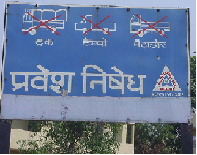
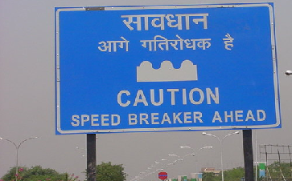
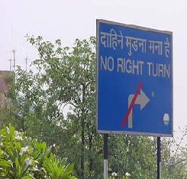
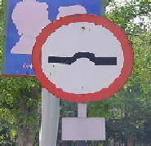
Common Deficiencies in Signs
Shape is wrong
  Cautionary sign on Round / Rectangular plate.
  Mandatory Sign on Rectangular plate.

Slide 31
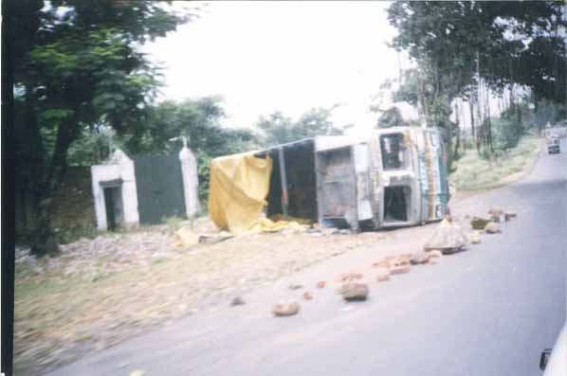
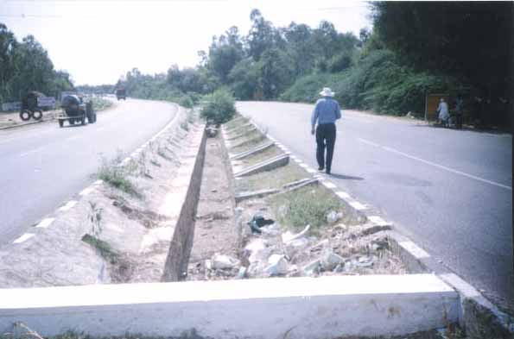
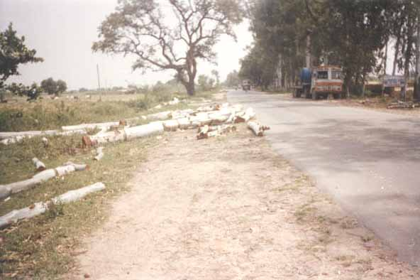
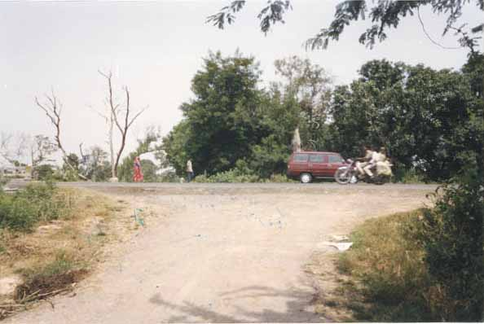
Roadside Accidents with Inadequate Protection made through Stones on the Carriageway can be Dangerous
Steep Median Drain without any Barrier Protection Leaving No Room for Recovery for Vehicles
Trees Removed to Make way for Up-gradation of Existing Road, Shoulder and Road Edge, Pose Road Safety Hazards
Access Created Without Proper Warning Signs and Speed Control Devices

Slide 32
QUESTIONS
?

Slide 33
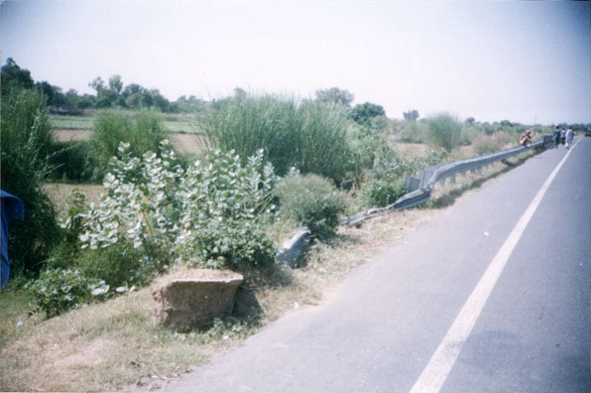
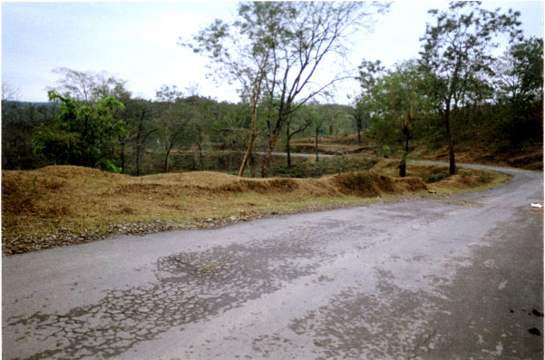
Detect the road safety problems in the following photographs?
Crashed Guard-rails on Roads not Repaired in Time could Lead to Accidents
Sharp Curve without any Warning Sign, with Trees on Bend and Steep Slopes

Slide 34
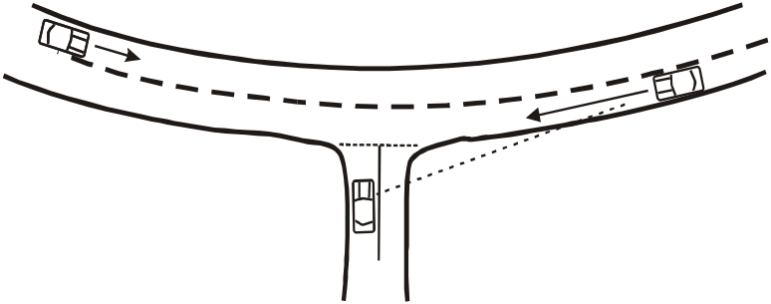
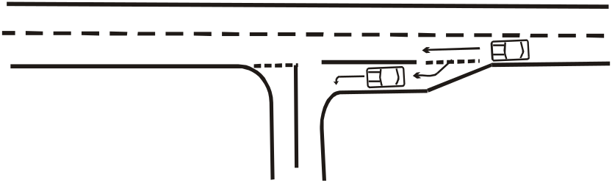
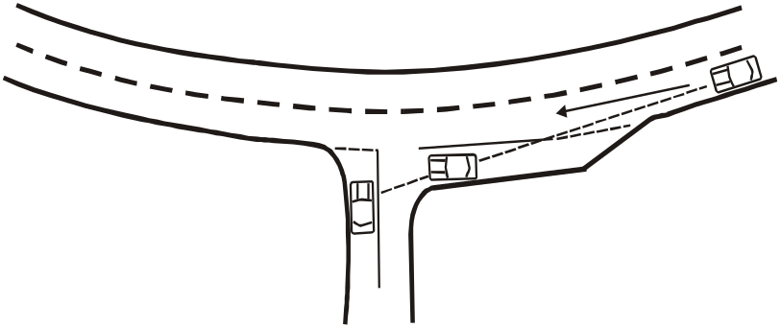
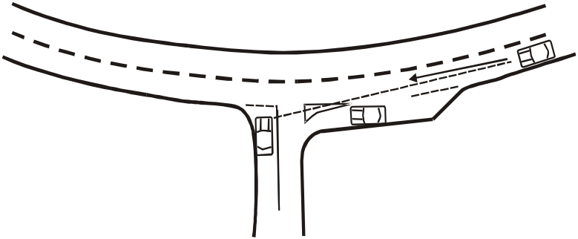
Explain how interaction of design elements can sometimes lead to hazardous situations?
(b) A deceleration lane reducing risk of nose-to-tail accidents
(a) A good horizontal sight distance from side road
(c) Combining elements in (a) & (b) restrict sight distance with a potential for right-angle accidents
(d) Intersection places the waiting vehicle in a position from which the driver can clearly see all the approaching vehicles

Slide 35
Road Safety Audit should be conducted during?
Day
Night
Day and Night
During Peak Hours
Answer: c)

Slide 36
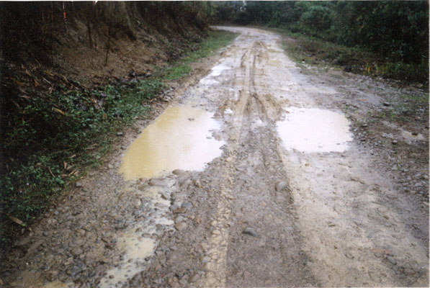
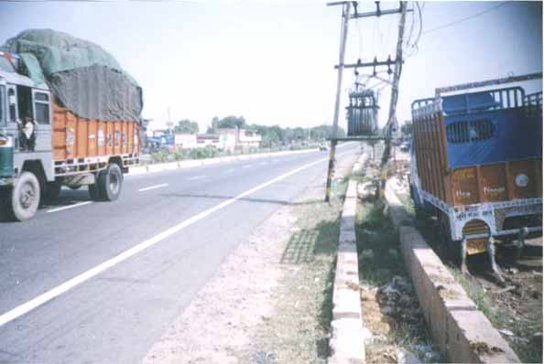
Detect the road safety problems in the following photographs?
Combination of Bad Road Surface & Poorly Maintained Shoulder leads to Hazardous Situation, Particularly in Wet Weather
Electric Transformer on NH-8 without Adequate Guard

Slide 37
Road Safety Audit is basically a measure for ?
Accident Reduction
Accident Investigation
Accident Prevention
Accident Investigation and Prevention
Answer: c)

Slide 38
Road Safety Audit is a ?
Reactive measure
Pro-active measure
Traffic Management Measure
None of the above
Answer: c)

Slide 39
Thank you

